Slide 1

Language Introduction
Language Introduction

Slide 2
Outline & Team Introduction
Origin of Ruby
Evolution of Ruby
Compare Java with Ruby
Language Features
Installation
Code Samples
Wang Yueyu
He Jiabei
Ahmed Farid

Slide 3




Origin of Ruby
“In 1993, when I saw Perl, I was somehow inspired that an object oriented language that combines characteristics of from Lisp, Smalltalk, and Perl would be a great language to enhance our productivity. So I started developing such a language and named it Ruby”
- Yukihiro “Matz” Matsumoto, Founder of Ruby
Ruby is the birthstone of July, which was that of one of Matz’s colleagues.

Slide 4
Evolution of Ruby
Start
Ruby-Talk
Ruby on Rails
The first English language Ruby mailing list
The framework which is great for developing web applications
1993
1998
2005
1995.12
1999
The Object-oriented Scripting Language Ruby.
Ruby 0.95
The first public version of Ruby
The first book on the Ruby programming language
Reference: https://www.sitepoint.com/history-ruby/

Slide 5
Difference between Java and Ruby
Java Program
Ruby Program
class Sample{
private static int fib (int n){
if (n<2) {
return n;
}
else{
return fib (n-2) +fib (n-1);
}
}
public static void main(String[] argv){
System.out.println("fib(6)="+fib(6));
}
}
def fib (n)
if n<2
n
else
fib(n-2)+fib(n-l)
end
end
print "fib(6)=",fib(6)
Looks like pseudocode:
Don’t need to define data types
Focus on the algorithm

Slide 6
Language Features
Duck Typing
Interpreted Scripting Language
Object-Oriented Programming
Modules
Code Block
Flexible grammar
Advanced
  Metaprogramming
  Garbage Collection
“They (programming languages) are the means of programming but also enhancers for your mind that shape the way you think about programming.”
- Yukihiro “Matz” Matsumoto

Slide 7
Duck Typing
“If it walks like a duck, quacks like a duck, it must be a duck.”
  If the behavior is like a duck, then whatever it is, consider it a duck.
  Do not consider an object belongs to which class, only concerned about what kind of behavior (methods) it has.
Static type
  Type mismatch can be found at compile time
  Run faster
Dynamic type
  Only program syntax errors can be found
  Simplicity
  Highlight the essence of program processing

Slide 8
Duck Typing
>> i = 0
=>0
>> a = ['100', 100.0]
=> ['100', 100.0]
>> while i < 2
>> puts a[i].to_i
>> i = i + 1
>> end
100
100
>> def add_them_up
>> 4 + 'four'
>> end
=> nil
>> add_them_up
TypeError: String can't be coerced into Fixnum
from (irb):56:in `+'
from (irb):56:in
Dynamic typing
  Ruby does not do type checking until you actually try to execute code.
  Your classes don’t have to inherit from the same parent to be used in the same way
  Duck typing doesn’t care what the underlying type might be.

Slide 9
Duck Typing
C++ Program (Static)
Ruby Program (Dynamic)
% Definition：
void log_puts(ostream out, char* msg);
% Implement:
log_puts(cout,"message");
# Defination：
log_puts (out, msg)
# Implement
log_puts (STDOUT, "message")
What should we do if we want to output to string?
  Copy logs_puts(), add a function that takes a string as the output
  output to the temporary file, and then read it into the string
require ‘stringio‘ # using StringIO
out = StringIO() # StringIO object
log_puts(out, "message") # output just like file

Slide 10
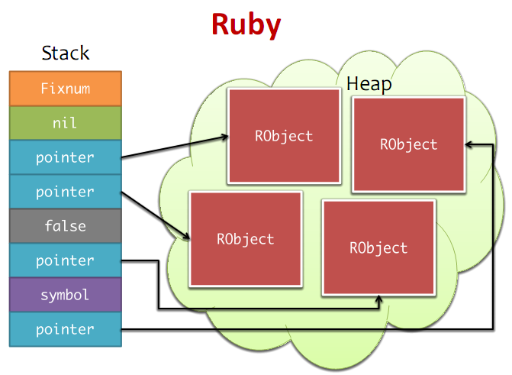
Interpreted Scripting Language
No need to declare variables
There are no specific types of variables
Variable can become any data type, because it just point to a Object.

Slide 11
Object-Oriented Programming
Everything in the Ruby’s world is an object, and Object is the father of all Ruby objects .
class Student
# Constructor
def initialize(name,id)
@name=name
@id=id
end
# Getter
def name
@name
end
def id
@id
end
# Setter
def setNameAndId(name,id)
@name=name
@id=id
end
end
Integer
Bignum
String
IO
Regexp
Module
File
Block
Object
Range
Symbol
Proc
Class
Hash
nil
Array
true
false
Exception
>> 4.class
=> Fixnum
>> 4.class.superclass
=> Integer
>> 4.class.superclass.superclass
=> Numeric
>> 4.class.superclass.superclass.superclass
=> Object
>> 4.methods
=> [:to_s, :inspect, :-@, :+, :-,:*, :/, :div, :%, :modulo,...]

Slide 12
Modules
Ruby objects are allowed to inherit only a single class. To over come this, modules allow the inclusion of methods and attributes.
module Introduce
def intro
puts “This is a #{self.class}… and his/her name is #{self.name}!”
end
end
class Person
include Introduce
attr_accessor :name #A way to do setter/getter in one line
def initialize(name)
@name = name
end
end
Person.new('John Cena').intro

Slide 13
Code Blocks
#1. { } style
a = [1,2,3]
b = “output:“
a.each { |item| puts b + item.to_s }
#2. do-end style
c = “external"
def test
c = “internal"
yield
end
test do
puts c #=>external
end
You can achieve the function callback, the transfer of code blocks is more flexible than the function pointer in C.
Code blocks must be attached to the function call. Function can use yield statement, and you can call the code block any number of times.

Slide 14
Flexible Grammar
def read
puts “read a book"
# In case of no ambiguity, whether you plus parentheses or not is ok.
puts(“read a book again")
# In case of no ambiguity, whether you plus semicolon or not is ok.
puts("still read a book");
end
read
read() # which do you prefer?

Slide 15
(Advanced) Metaprogramming: Reflection
A language is also the ability of its own meta language called reflection, the language of the program can be run at the time to observe and modify their own structure and behavior.
eval，module_eval, class_eval, defiend_method, undef_method, remove_method, instance_variable_set, extend，methods, public_methods, instance_variables
class Thing; end
a = %q{def hello() “Hello there!” end} #string contains a method definition
Thing.module_eval(a) #let the method definition in string become real definition in class
puts Thing.new.hello() #=>Hello there!
Thing. instance_variable_set(a) #set variable
puts Thing.new.a #=> {def hello() “Hello there!” end}

Slide 16
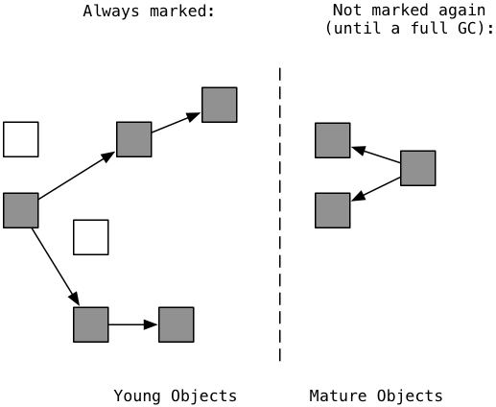
(Advanced) Garbage Collection
Ruby achieves a mark and sweep garbage collection mechanism. There are two type objects in GC system, one is Young Object, another is Mature object.
In most cases, programmers don't need to worry about garbage collection.
Of course, the GC module provides the interface that allows sweeping when you need.

Slide 17
Language Drawbacks
Performance
This is Ruby’s Primary weakness due to its nature as a scripting language and heavy use of OO. However it is getting faster overtime, and there are efforts to create a VM (Like Java’s JVM) and a Just-In-Time compiler.
Concurrency & OOP
OO Programming (Behavior wrapped around a changing state) causes concurrency problems due to the change of object state.
Type Safety
Duck (Or dynamic) typing does not easily allow the creating of syntax trees to validate code, which is important for IDEs to properly operate.

Slide 18
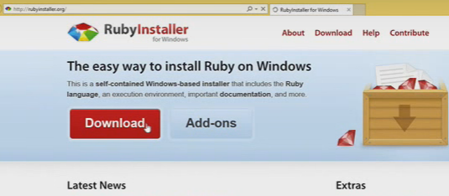
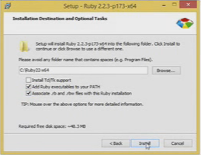
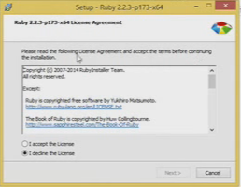
How to install: Windows
Download the installer from here: http://rubyinstaller.org/
Open the installer and agree to the terms
During installation, make sure to mark “Add Ruby to PATH” and “set .rb files to Ruby”, then click install
1
3
2

Slide 19
How to install: Other
Mac OSX
Comes pre-installed with Xcode. Download latest Xcode from app store
Ubuntu
Using the terminal: sudo apt-get install ruby

Slide 20
Code Sample 1: Hello OO world!
s = Student.new(‘Your name’,’Any ID’)
puts s.name,s.id
s.setNameAndId(‘Other name’,’Other id’)
Puts s.name,s.id
class Student
# Constructor
def initialize(name,id)
@name=name
@id=id
end
# Getter
def name
@name
end
def id
@id
end
# Setter
def setNameAndId(name,id)
@name=name
@id=id
end
# Other way to do get/set #attr_accessor :name, :id
end
2
Append 1 & 2
1

Slide 21
Code Sample 2: File writing
module ToFile
def filename
"object_#{self.object_id}.txt"
end
def to_f
File.open(filename,'w'){|f| f.write(self.name)}
end
end
class Person
include ToFile
attr_accessor :name
def initialize(name)
@name = name
end
end
Person.new('Your name').to_f

Slide 22
Code Sample 3: The modified ‘Float’ class
class Float
def mile
self
end
def kilometer
self * 1.6
end
def nautical
self*0.868976
end
end
n = 5.0;
puts n.kilometer
puts n.nautical

Slide 23
Code Sample 4: Rate this presentation! (HTTP GET)
Copy the Ruby code from here:
https://github.com/amwfarid/ProgLangRubyPresentationWaseda/blob/master/HttpGet.rb
Read the code carefully to understand it
Change rating and comments
Run the code
Open the link at the bottom of the code to view live results!

Slide 24
Language Introduction
Thank you for your time!
By:
Wang Yueyu
He Jiabei
Ahmed Farid

Slide 25
Flexibility: Duck typing
As long as you walk like a duck, quack like a duck, I think you are a duck.
There is a important rule in OOD: Coding oriented to interface. It is easy for Ruby!
class GENIUS
def start
puts “GENIUS starts"
end
def stop
puts “GENIUS stops"
end
end
class FOOLS
def start
puts “FOOLS starts"
end
def stop
puts “FOOLS stops "
end
end
def test_GENIUS_start_stop(genius)
genius.start
genius.stop
end
# both two classes is ok!
test_GENIUS_start_stop(GENIUS.new)
stop(FOOLS.new)

